Slide 1

Team X Simon, Marina, Nav, Jesse, John, Jonathon
Problem statement 7:
Learning from feedback: “How could Generative AI be used to ensure government can best respond to questions from the public for HMRC Feedback?”
Notes:
“We’ve created a tool to improve user experience and communications across the Gov.UK platform, helping to streamline responses and connect you to the right team to resolve your problems quicker

Slide 2
Introduction
Today:
Over a million pieces of feedback on GOV.uk sites per year
Analysts manually correlating and categorising trends, months after feedback provided
Users submitting serious or urgent feedback to HMRC receive no response
Our GenAI tools:
Impact:
To HMG:
Analysts’ time saved
Website issues better addressed, more quickly
To the user:
Users receive help, rather than being ignored
Transparency and inclusivity
Government takes more accountability for feedback provided
Tools: OpenAI, Python, HuggingFace Spaces, StreamLit, Langchain
Generative AI Feedback tool
Classification done automatically
Users receive instant response to feedback
HMRC Feedback Dashboard
Feedback themes identified in real time
Analysts able to see where issues exist, and respond efficiently

Slide 3
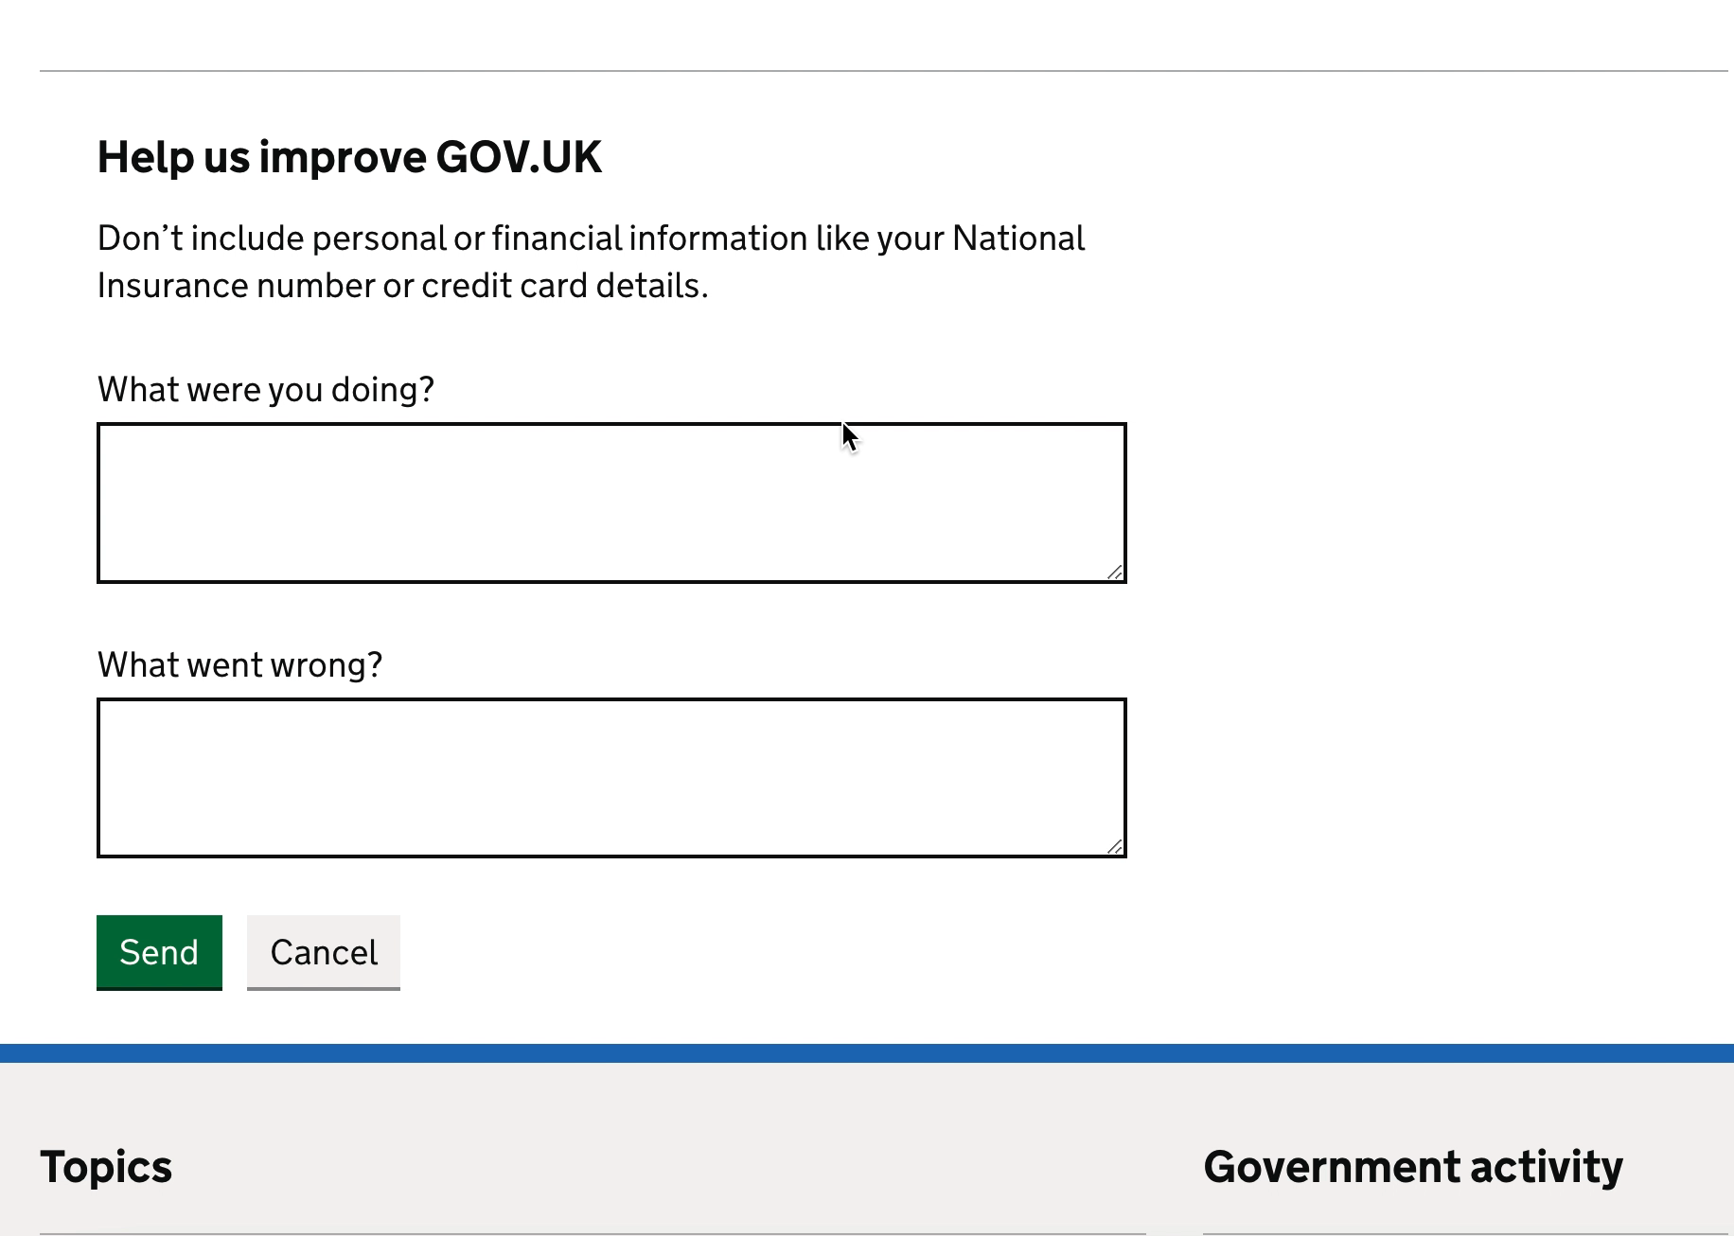
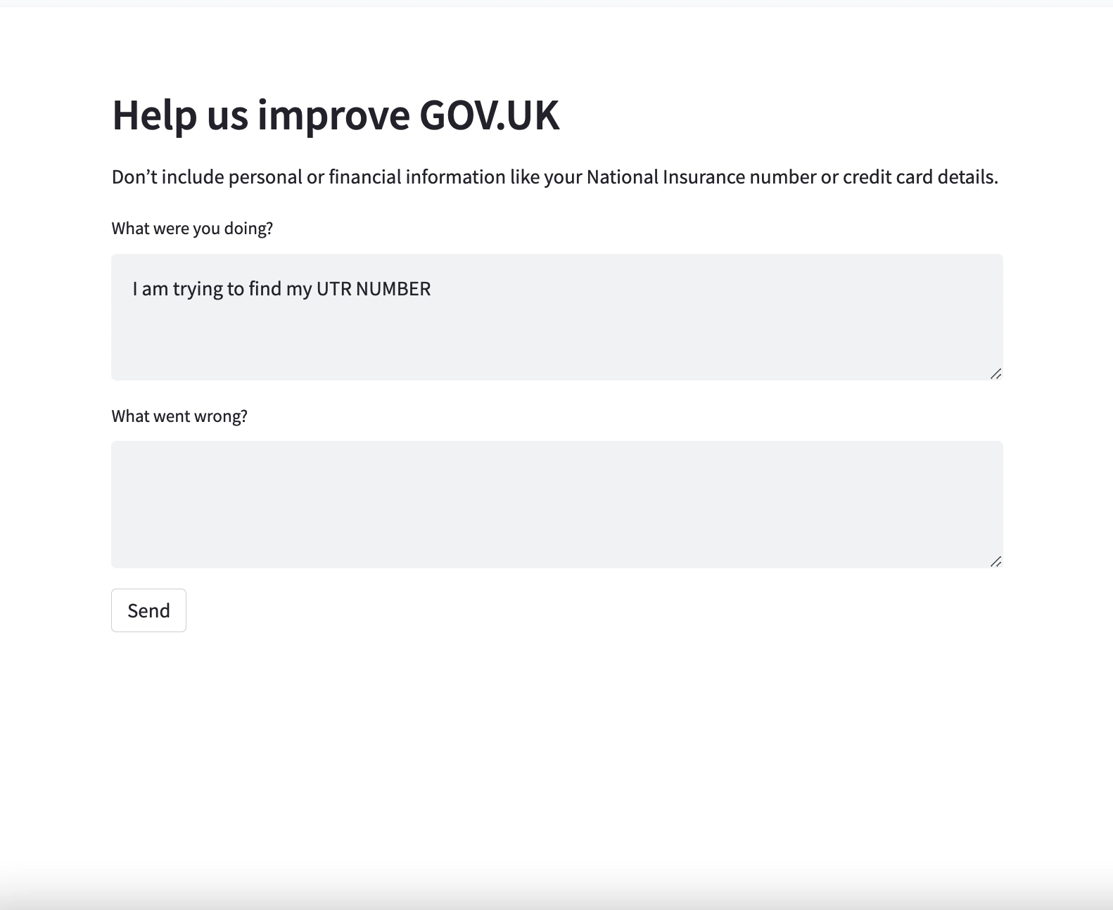
Towards Intelligent Feedback Tool
Current
Proposed

Slide 4
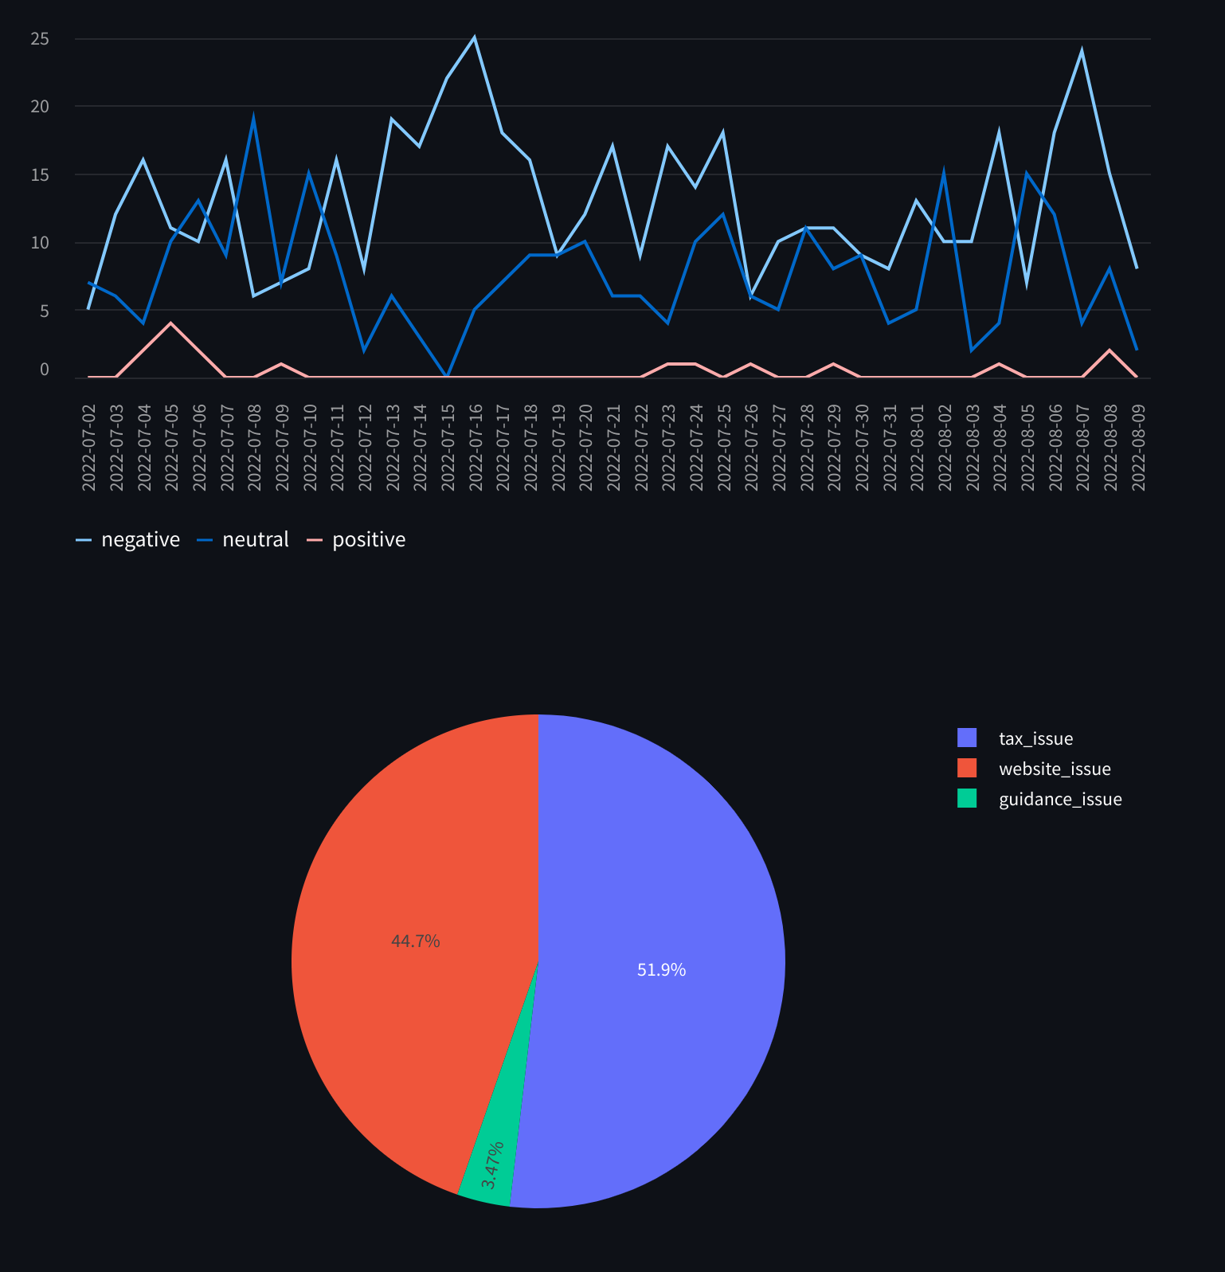
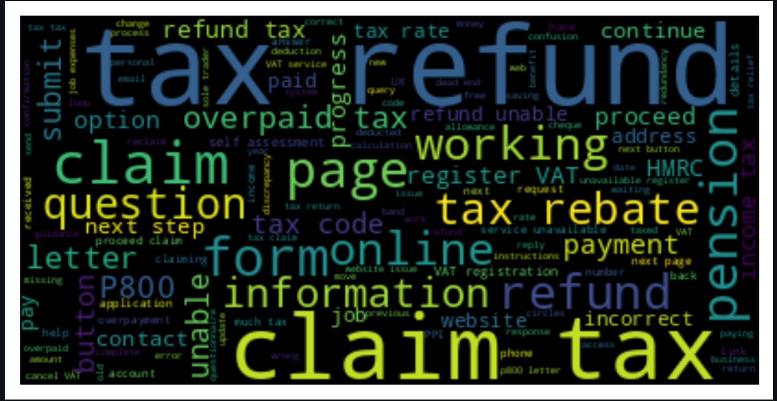
HMRC Feedback Dashboard – Sentiment Analysis Learning from feedback: Leveraging advanced AI (OpenAI) to understand customer feedback together
Sentiment Analysis on Feedback Over Time
Types of Issues Identified
Word Cloud to segment keywords

Slide 5
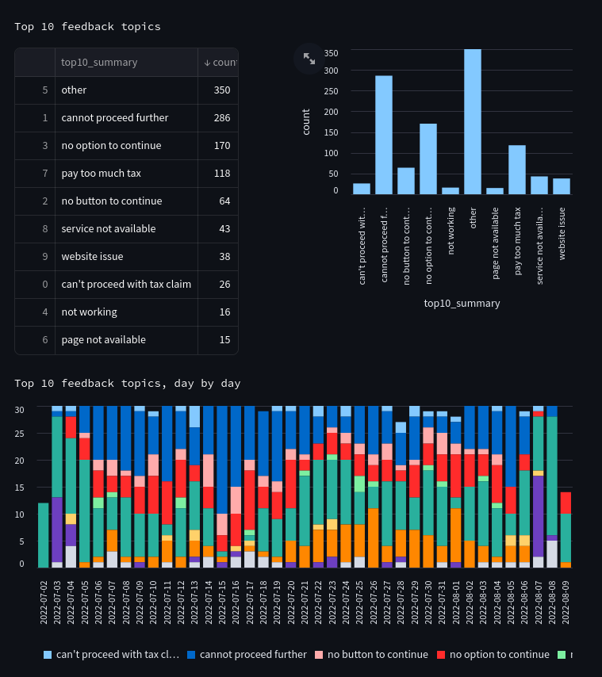
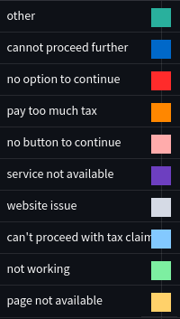
HMRC Feedback Dashboard – Top Issues Learning from feedback : Leveraging AI to classify top 10 feedback topics
“Dead end”
“Unable to continue” “Will not let me go any further than this page.”
"Cannot proceed“ 1. What did you pay too much tax on?
Pay from your current job
2. When did you pay the tax?
Between 6 April 2021 and 5 April 2022 3. Have you got a P800 letter from HMRC? Yes

Slide 6


